Slide 1
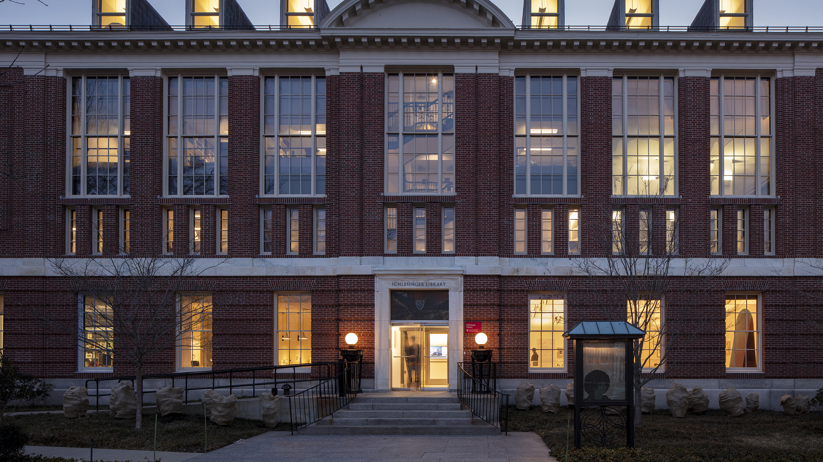
Documenting Women's History at the Schlesinger Library

Slide 2
Maud Wood Park
Shown here in 1928
Radcliffe College class of 1898
Suffrage activist
Donated Woman's Rights Collection in 1943

Slide 3
Arrival of the Woman's Rights Collection at Radcliffe August 1943
Students pull a wagon that once sold the suffrage newspaper The Woman’s Journal to Longfellow Hall

Slide 4
Woman's Rights Collection displayed in Longfellow Hall

Slide 5
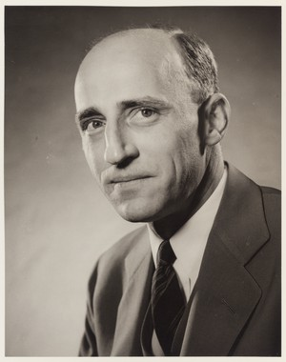
Radcliffe College President Wilbur K. Jordan
Historian Mary Ritter Beard

Slide 6
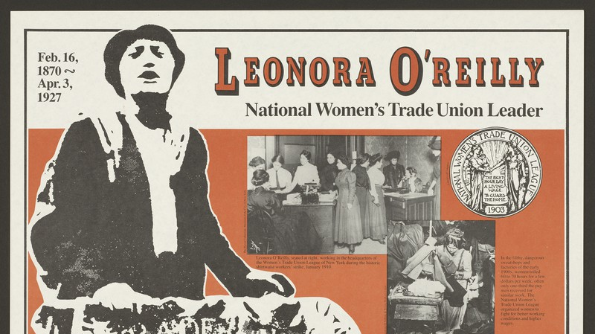

Slide 7
Women's Archives room in Byerly Hall

Slide 8
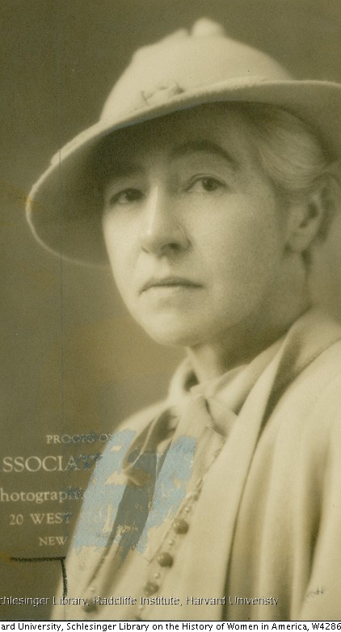
Miriam Van Waters
Hilda Worthington Smith

Slide 9
Beecher Stowe family papers
Letter from Lyman Beecher sent to his daughter Catherine, 1827

Slide 10
1961: Widener transferred 1,500 cookbooks to Women's Archives

Slide 11
Arthur and Elizabeth Schlesinger
Elizabeth with Matina Horner
Arthur with Barbara Solomon

Slide 12
Schlesinger Library, 1971
Director’s office

Slide 13
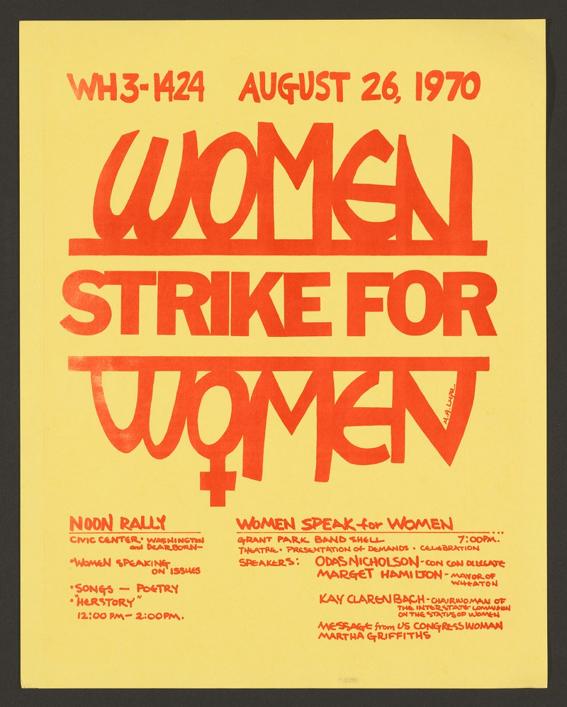
Women​ demand equality

Slide 14
Gerda Lerner Bernice "Bunny" Sandler

Slide 17
Black Women Oral History Project

Slide 18
Women's organizations

Slide 19
Radcliffe College Archives

Slide 20
Victoria Ogden Howarth (Class of 1911) scrapbook

Slide 21
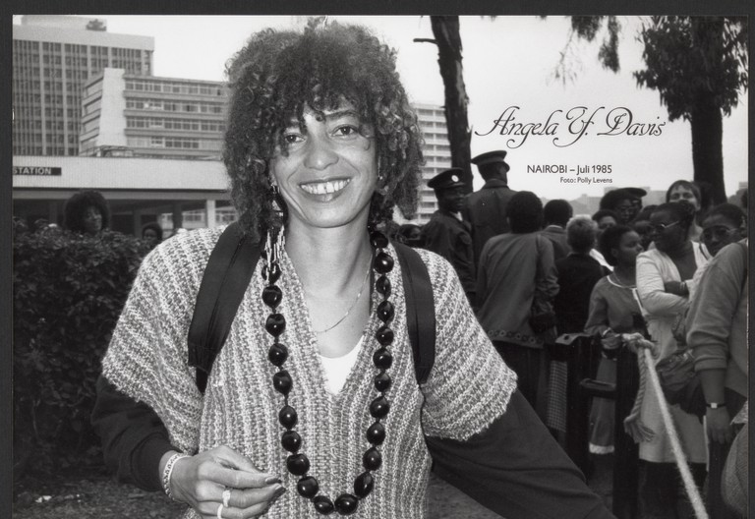
Black feminists
Angela Y. Davis
June Jordan

Slide 22
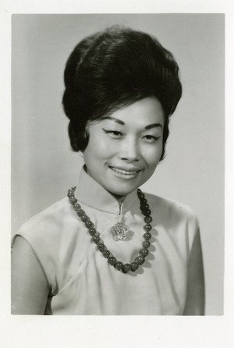
Conservative women
Anna Chennault
Mildred Jefferson (shown here with Phyllis Schlafly)

Slide 23
Eleanor Skelton Cash diary, ca.1986

Slide 24
Pauli Murray Adrienne Rich

Slide 25
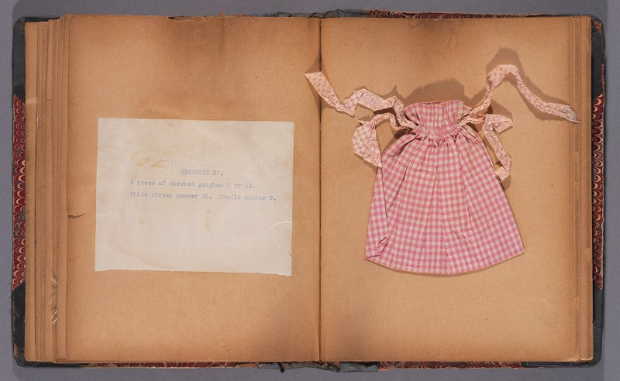
"ordinary" women
Beatrice Jeanette Whiting, 1915
Jennifer Halpern, 1975

